Slide 1

Interactive Brokers Python API
A Guide for Downloading Data, Managing Accounts, and Trading

Slide 2

IB PYTHON API (ibapi)
Account Info
- Balances & Positions
Market Data
- Historical & Real-Time
Orders & Execution
- Place, Modify, Cancel, Track

Slide 3
Environment SET-UP
IB Account
Create IB account & enable API access
Install Trader Workstation (TWS) or IB Gateway
Python Environment
Install Python 3.7+
Install the IB API Python package: pip install ibapi
Optionally, download latest API from: interactivebrokers.github.io

Slide 4

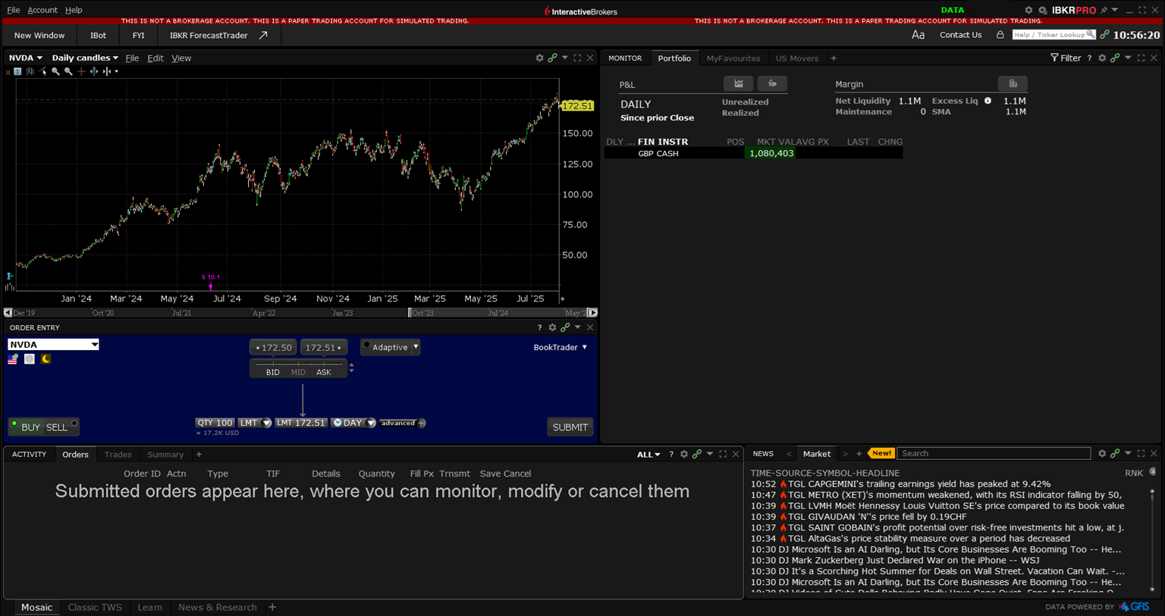
Trader workstation (tws)

Slide 5
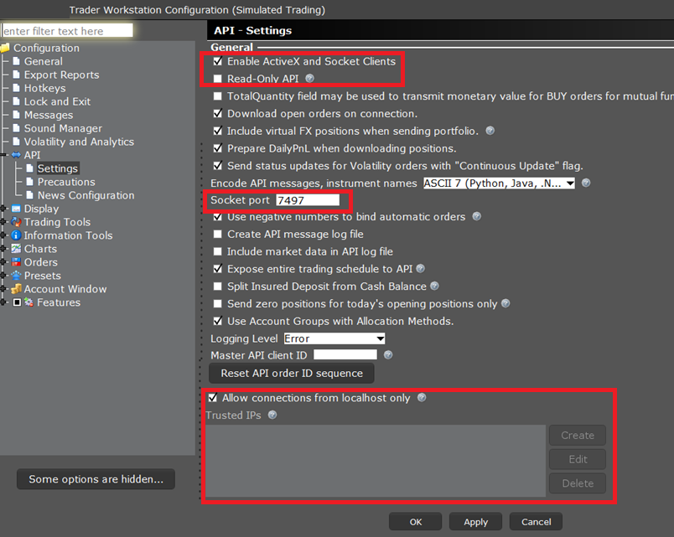
API Settings

Slide 6
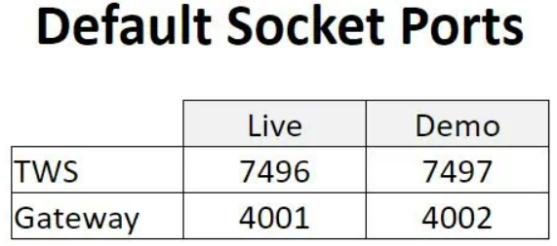
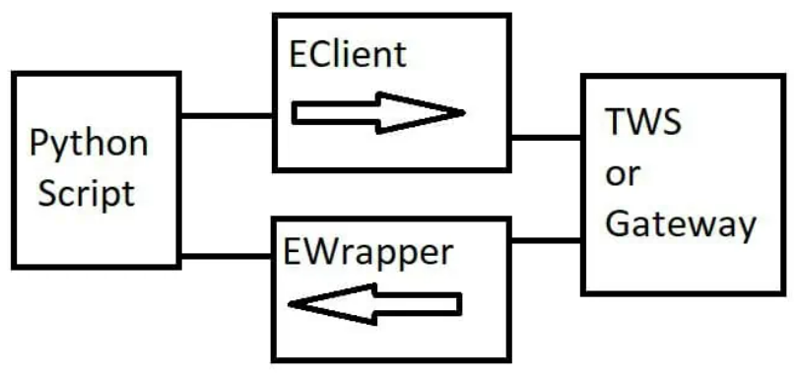
connection framework
Connects through TWS or IB Gateway via TCP socket
Combines sending requests (EClient) and receiving callbacks (EWrapper)

Slide 7
Asynchronous events
API is event-driven and asynchronous
Requests are non-blocking; responses come via callbacks
Common patterns:
Run API client in separate thread or event loop
Use synchronization methods (e.g., flags, events) to wait for data
Requires non-blocking programming mindset

Slide 8
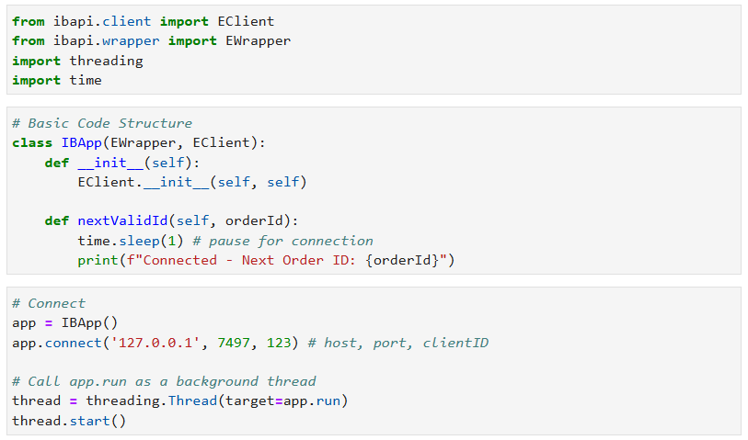
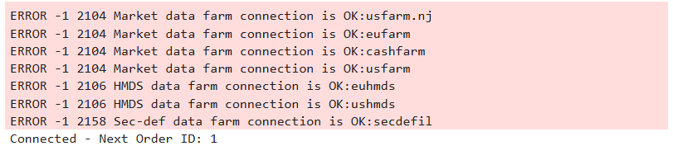
TWS CONNECTION
TWS Connection Code
Connection Response
ERROR means console output

Slide 9
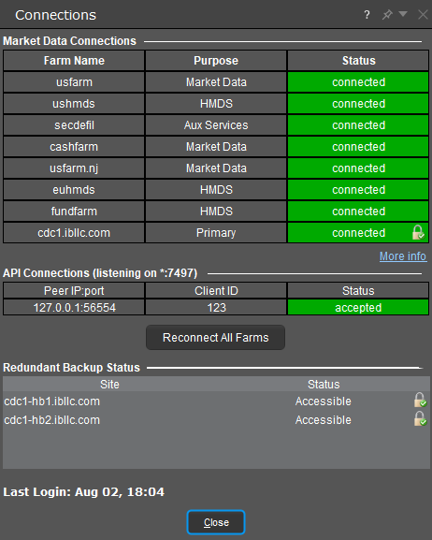
TWS CONNECTION

Slide 10
Account summary & Positions
Use reqAccountSummary or reqAccountUpdates to get balances/cash
Use reqPositions() to get held positions
Important callbacks:
accountSummary(...) — for balances
position(account, contract, position, avgCost) — for positions
positionEnd() — signals completion

Slide 11
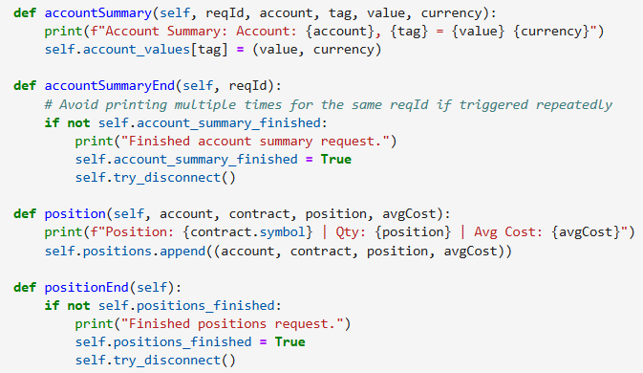
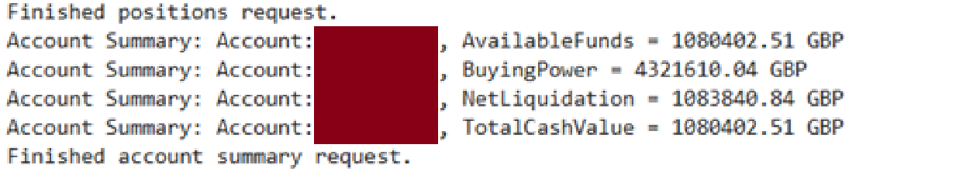
a/c summary & positions
Account Summary & Positions Code
Account Summary Response
Simulation account has no positions and a cash balance

Slide 12
Downloading market data
Create a Contract object (specify symbol, exchange, secType, currency)
Use reqHistoricalData method to request historical data
Parameters to specify:
durationStr (e.g., '1 M' for 1 month)
barSizeSetting (e.g., '1 hour’)
whatToShow ('TRADES' for trade data)

Slide 13
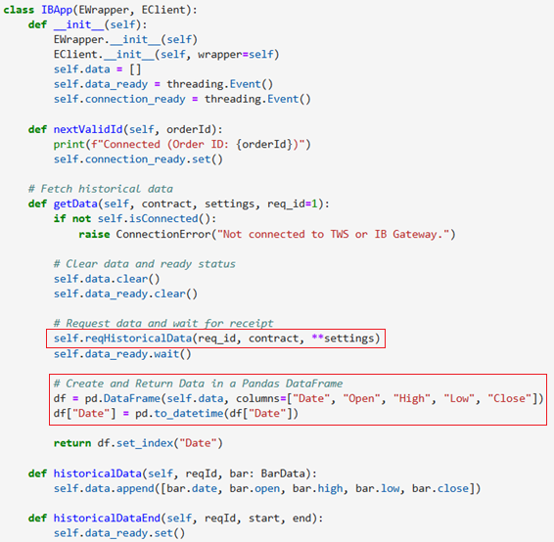
Market Data Requests
Market Data Requests
Request Market Data

Slide 14
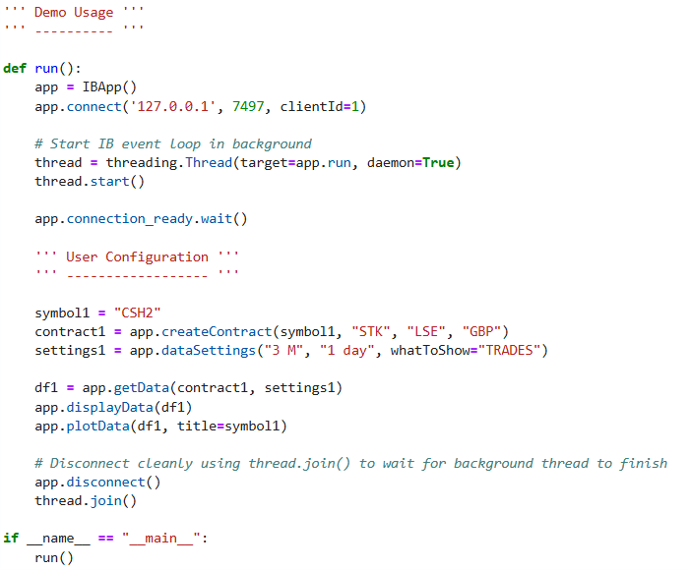
Market Data Configuration
Market Data User Configuration
Contract – CSH2 Money Mkt ETF
Daily Trade Data for 3 months

Slide 15
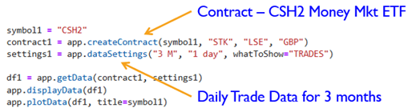
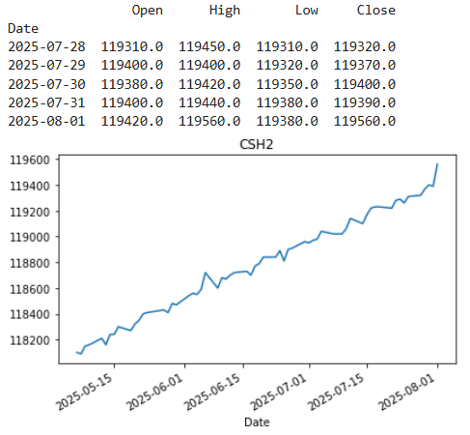
Market Data RESULTS
Market Data Request
Market Data Results

Slide 16
Placing orders
Build an Order object specifying:
action (BUY/SELL)
orderType (e.g., MARKET, LMT)
totalQuantity
Submit order via Python
app.placeOrder(orderId, contract, order)
Track orders using callbacks:
orderStatus(...)
openOrder(...)
execDetails(...)

Slide 17
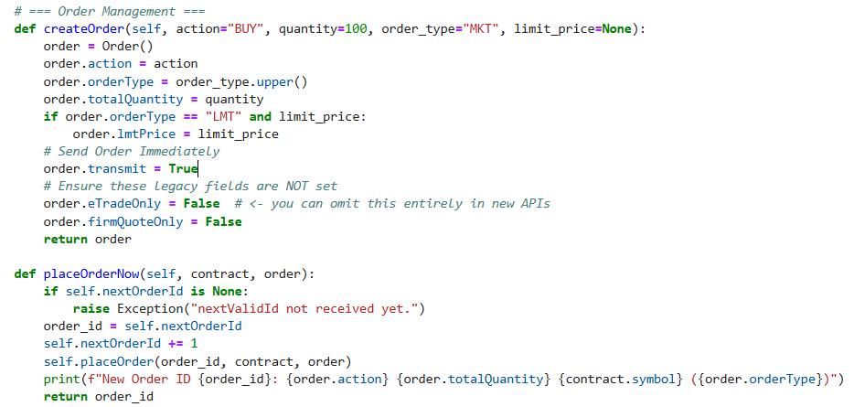
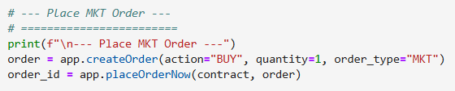

Placing orders
Placing Orders
TWS Order Screen

Slide 18
ORDER MANAGEMENT
MODIFY
Modify by re-submitting order with same orderId and new parameters
CANCEL
Cancel pending orders using cancelOrder method
app.cancelOrder(orderId)
STATUS
Get live order status using ‘orderStatus’ callback method
Receive execution updates using ‘execDetails’ callback method

Slide 19
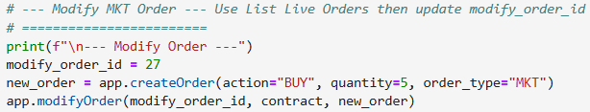

Modify order
TWS Order Screen BEFORE
Modify Order
TWS Order Screen AFTER

Slide 20

cancel order
TWS Order Screen BEFORE
Cancel Order
TWS Order Screen AFTER

Slide 21
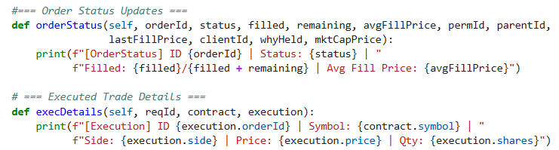
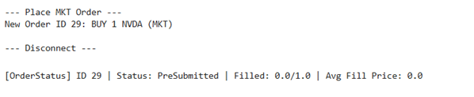
Order STATUS
TWS Order Screen
Order Status & Execution Details – Python Callback Code
Python Result

Slide 22
KEY methods & callbacks
Task | Callback Method
Connect | connect( host, port, client_id )
Historical Data | reqHistoricalData(), historicalData()
Real-time Data | reqMktData(), tickPrice(), tickSize()
Account Summary | reqAccountSummary(), accountSummary()
Positions | reqPositions(), position(), positionEnd()
Place Orders | placeOrder(), orderStatus(), execDetails()
Modify Orders | placeOrder() with same orderId
Cancel Orders | cancelOrder()

Slide 23
Resources
IB Official API Documentation https://interactivebrokers.github.io/tws-api/index.html
Algotrading101 IB Python API Guide https://algotrading101.com/learn/interactive-brokers-python-api-native-guide/
Interactive Brokers Campus - Python TWS API Course https://www.interactivebrokers.com/campus/trading-course/python-tws-api/

Slide 24
Closing remarks
Tips
First, try on a simulation account (demo account)
Start small and do plenty of testing before placing real orders
Subscribe for more info and resources
Quant YouTube Channel: www.youtube.com/@algoquanthub
Quant Newsletter: https://algoquanthub.beehiiv.com/subscribe
Follow me on Linked-In www.linkedin.com/in/nburgessx

